Slide 1


MICROSOFT AZURE

Slide 2
Microsoft Azure
Team members
Shreyas
Ullas
Sharath Kumar
Sanket Pawar
Manisha
Shreeya
Sanjana
Sakshi
Vaishnavi
Shrinidhi
Sushmitha
Tanisha

Slide 3

What Is Cloud ?
An approach to computing that’s about internet scale and connecting to a variety of devices and end points
Key characteristics of CLOUD
Pool of shared resources
Elasticity of scalability
Self service automation
Any where access

Slide 4
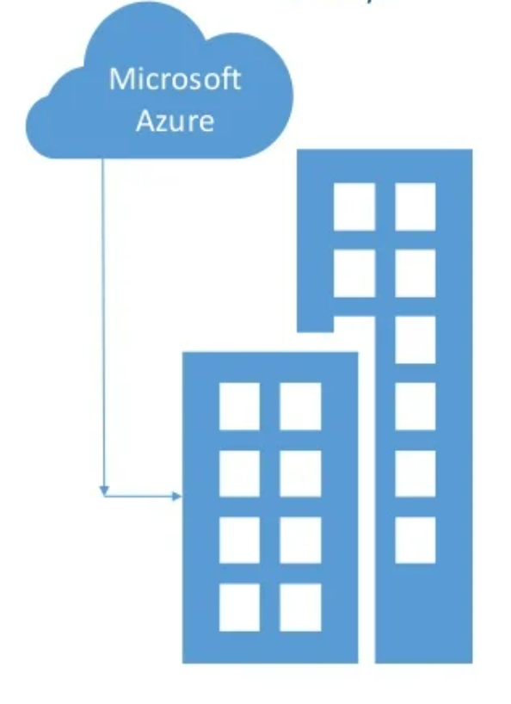
Microsoft Azure
It is a Microsoft’s Cloud platform: a growing collection of growing collection of integrated services – compute, storage, data, networking and application.
It is a combination of IaaS and Paas
It’s a hybrid Ready
It is open and flexible
It is always up and always on
It is economical and scalable

Slide 5
What can you do using AZURE ?
Build Infrastructure virtual machines, virtual network, storage, backup
Develop modern applications websites, mobile services, integration, Dev-test
Gain insights from data SQL Database, HD Insight
Manage identify and access active directory, multi factor authentication

Slide 6
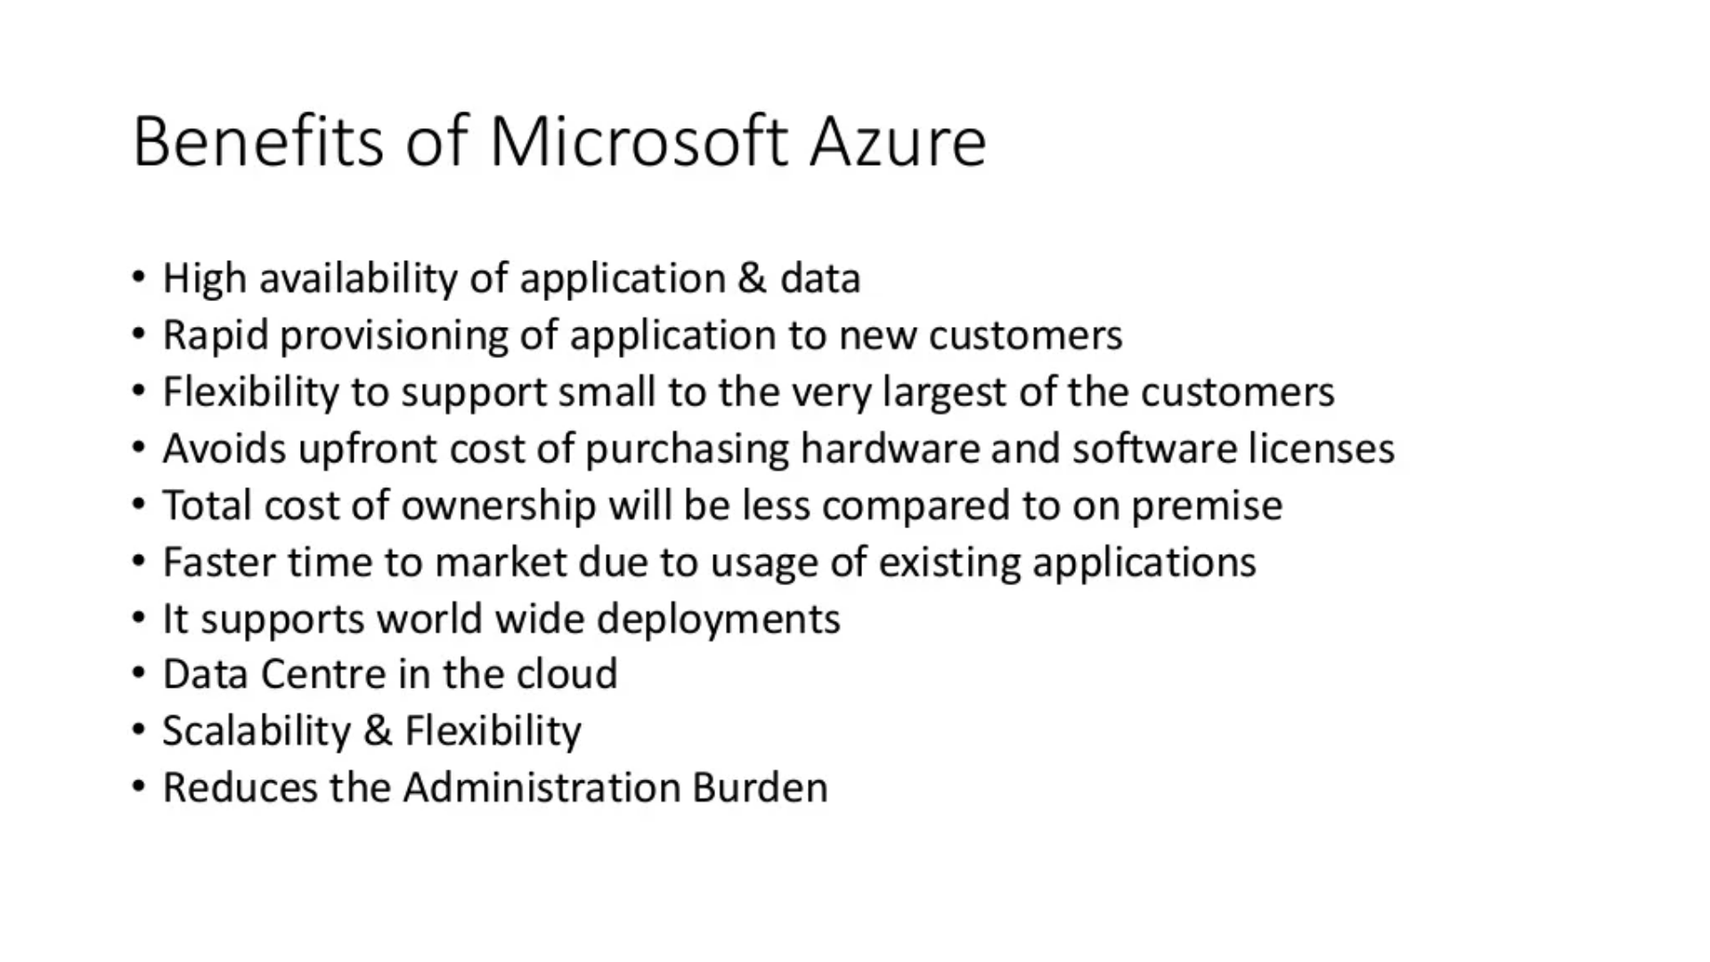

Slide 7

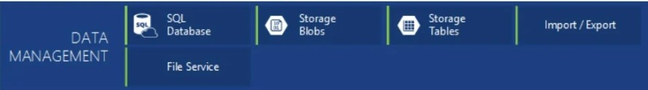
Components of Microsoft azure:

Slide 8
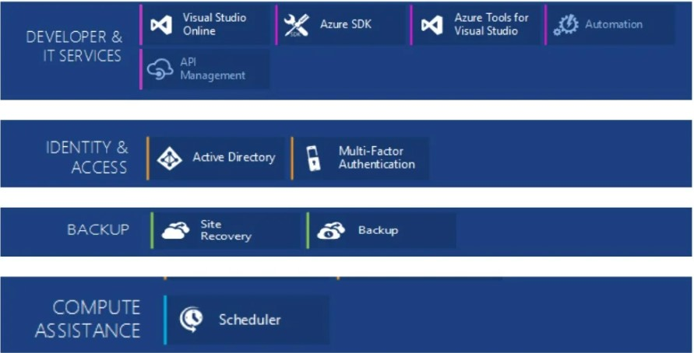

Slide 9
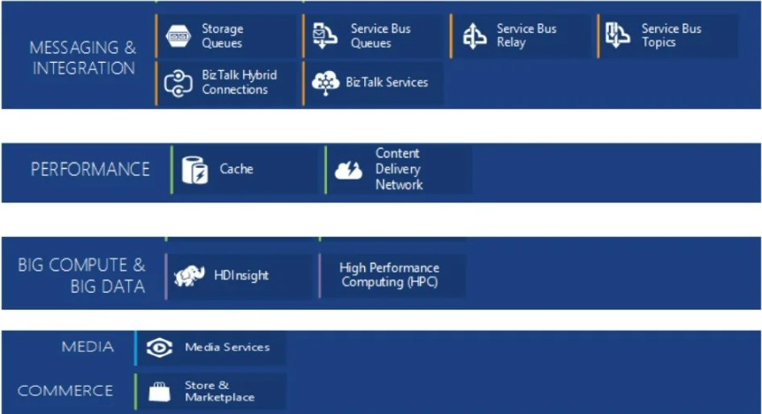

Slide 10
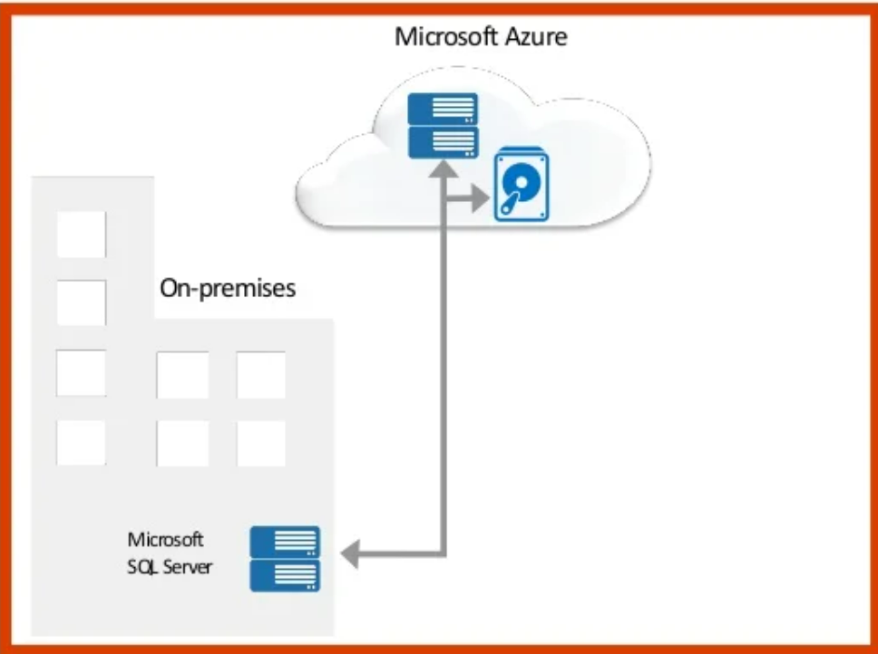
Data backup in the cloud overview
A range of applications : SQL server, file servers, SharePoint, Exchange.
Encrypted backups and global, geo-redundant datacenters.
Consumption-based pricing. No hardware and backup media costs.
Intuitive management with familiar tools across on-premises and cloud.
Provision more storage for your customers as needed.

Slide 11
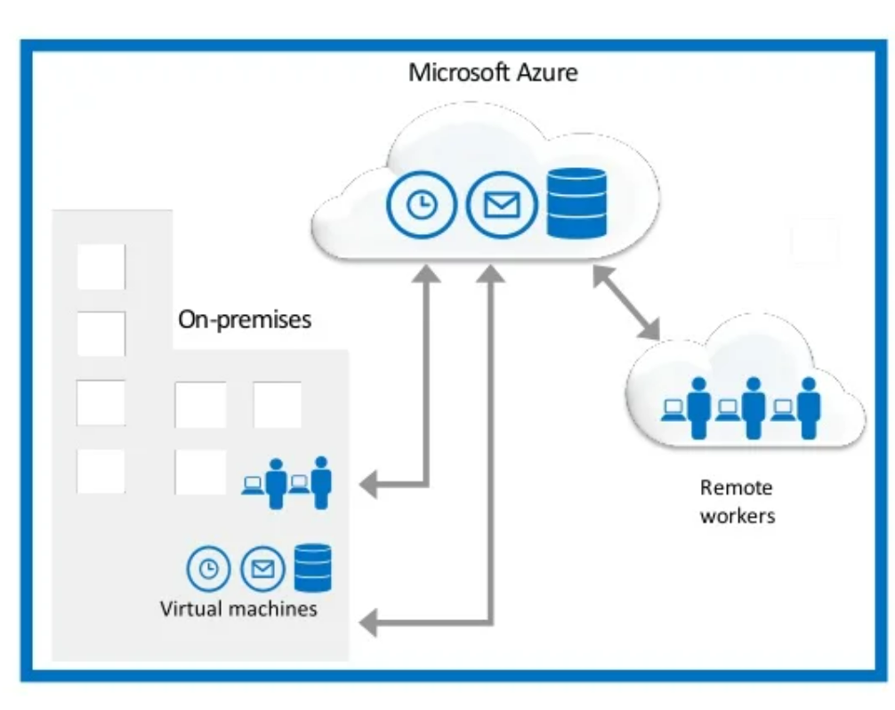
Mircosoft Azure VMs overview
Deploy applications to the cloud
Extend your environment
Best platform for SharePoint and SQL Server development and test
Scalable on-demand infrastructure
Best in class price-performance and end-to-end support

Slide 12
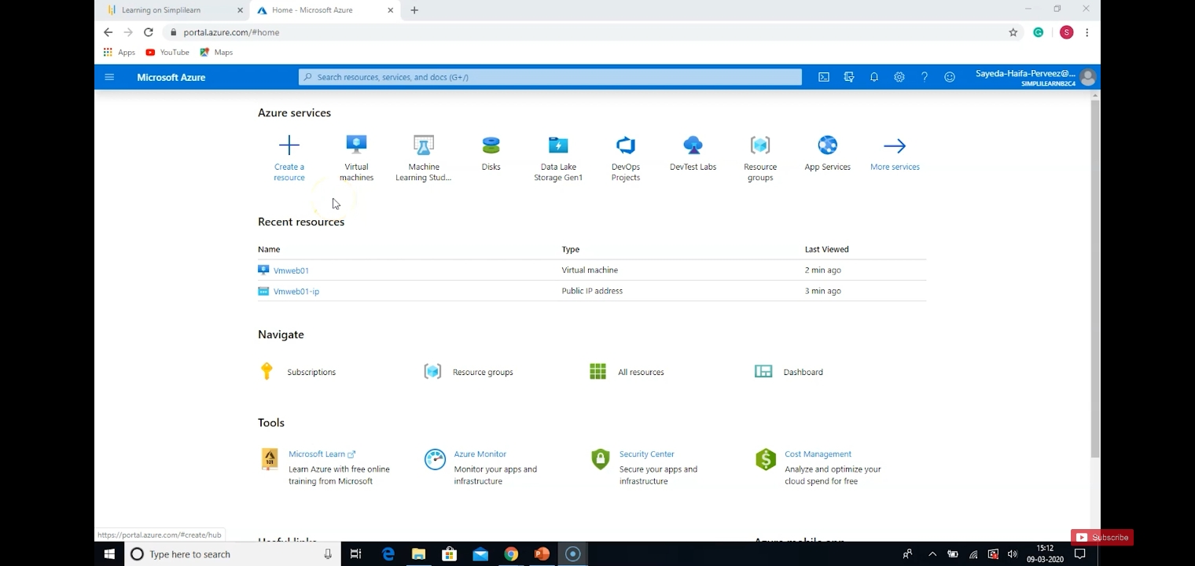
Creating a Virtual machine, create and modify the web server
Login to azure with your credentials.

Slide 13
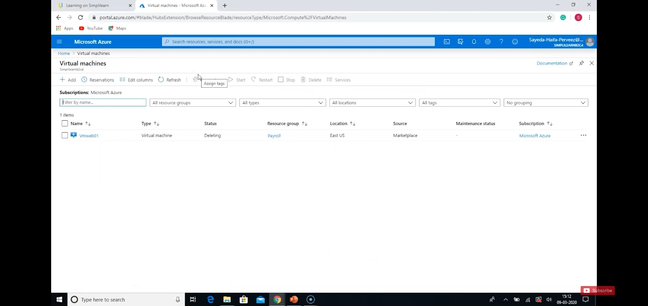
Click on add.

Slide 14
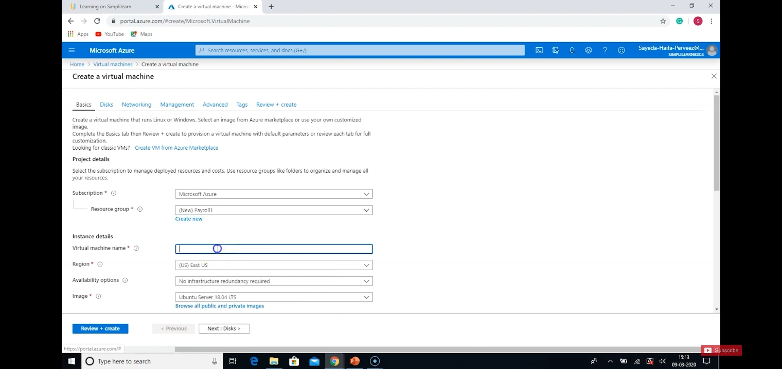

Slide 15

Select VM size

Slide 16
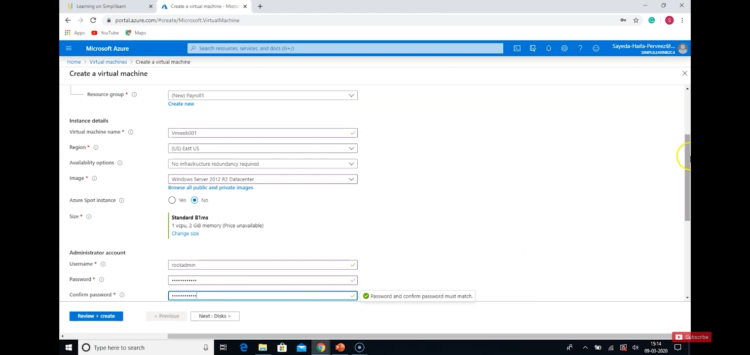
Create administrator account by giving username and password.

Slide 17
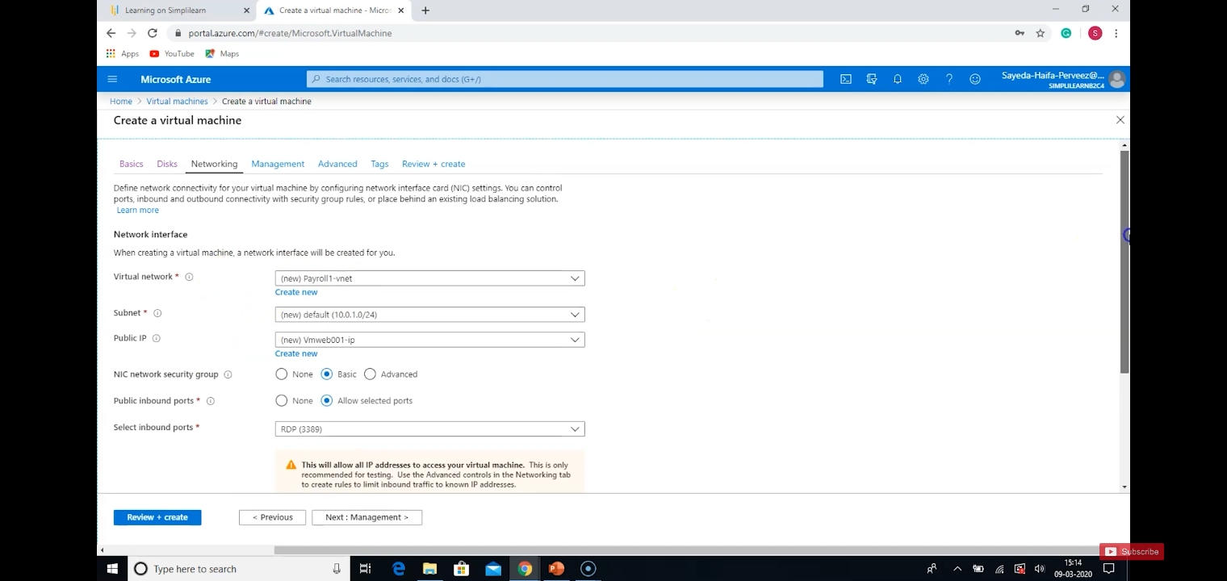

Slide 18

The virtual machine is deployed.

Slide 19
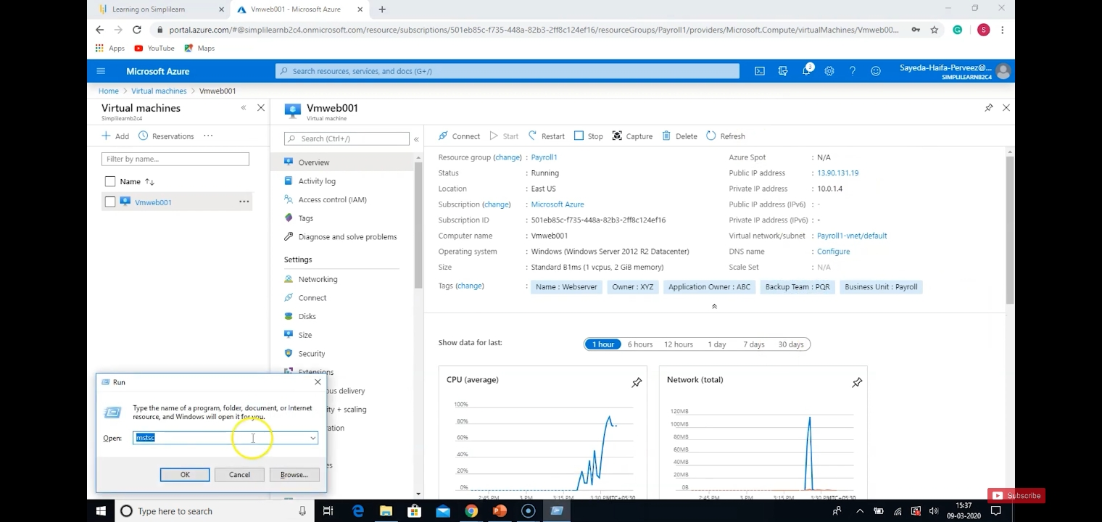

Slide 20
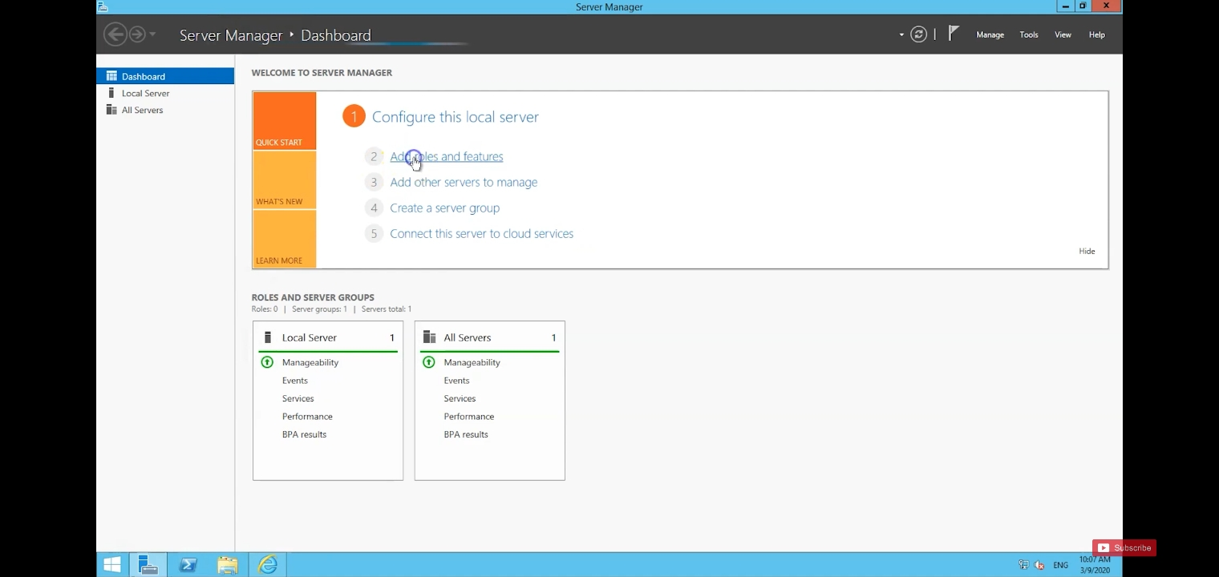
Select server manager > add roles and features

Slide 21
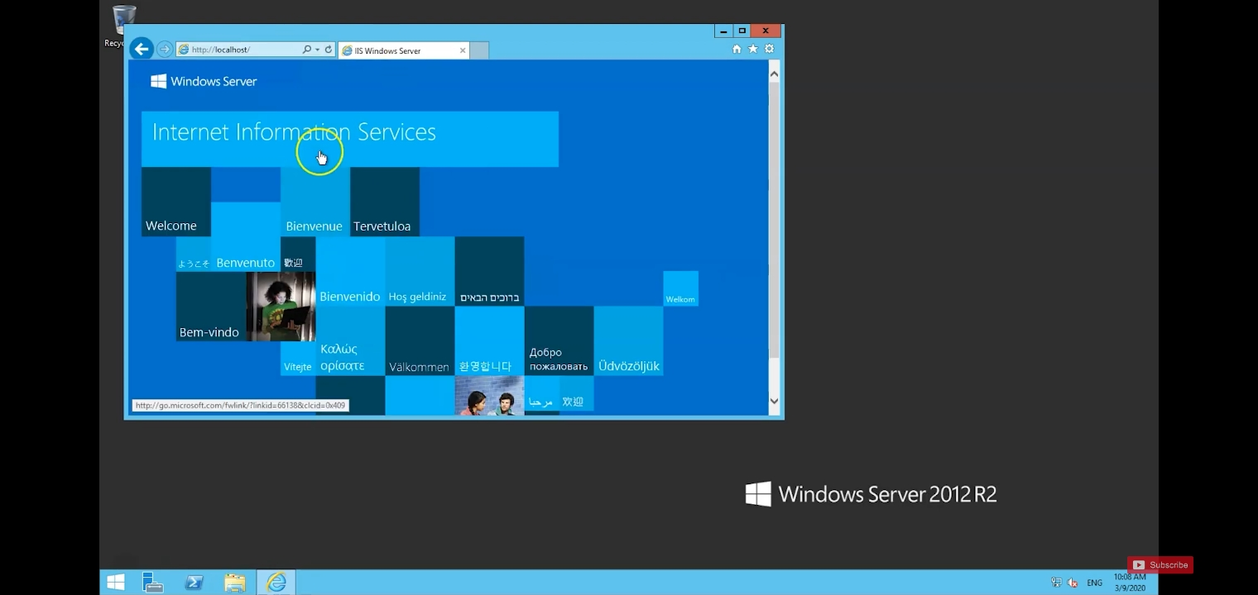
Open internet explorer > type http://localhost/

Slide 22
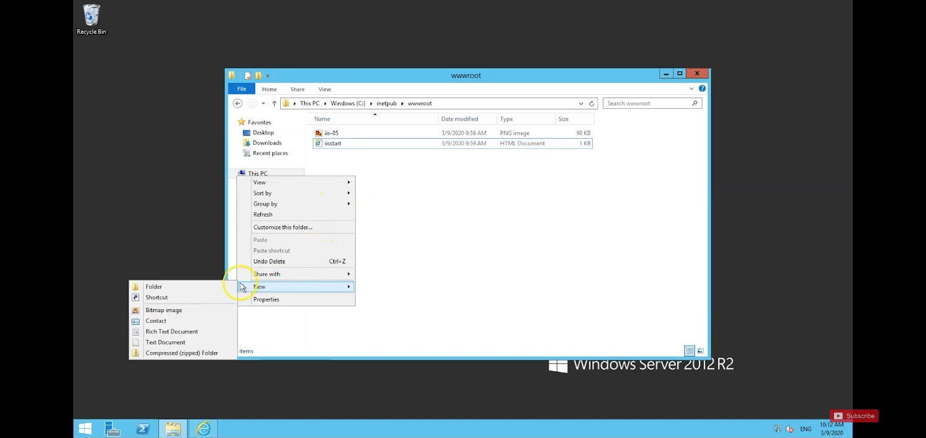
Go to file explorer > inetpub > wwwroot > create new text document > open with internet explorer

Slide 23
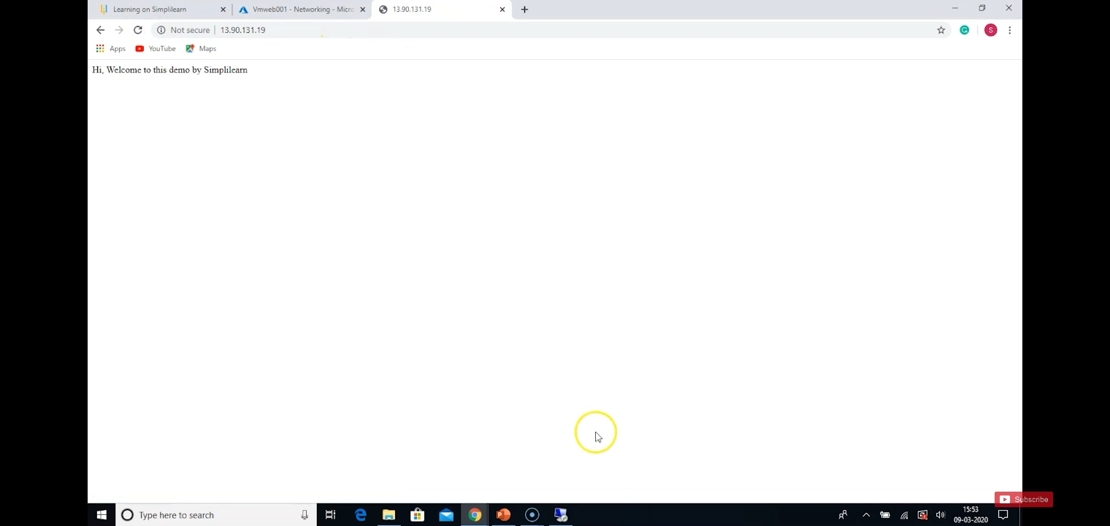

Slide 24
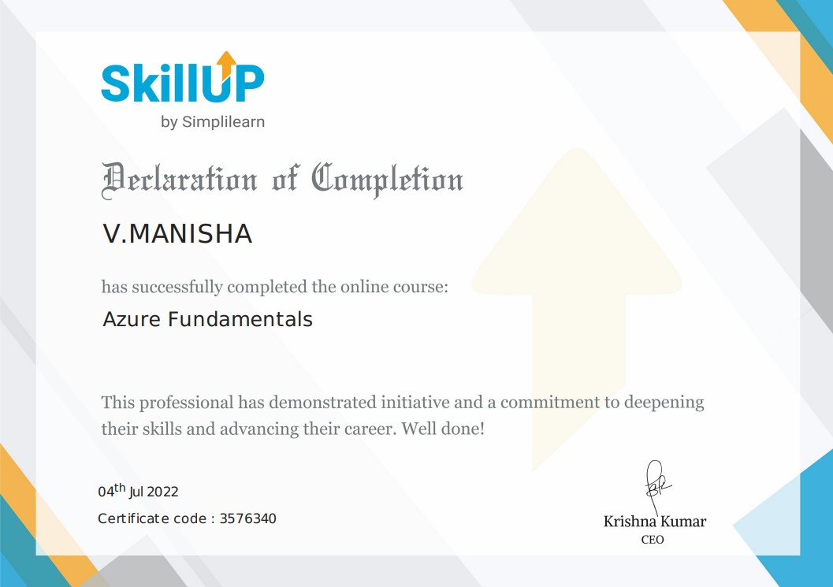

Slide 25

THANK YOU

